Slide 1

METEORITE LANDINGS
DATA VISUALIZATION - PROJECT 2 – GROUP 1
Alekya Gadiraju, Edyson Katuuo, Jenish Jariwala, Jess Hunter

Slide 2
1 Introduction
2 Data Collection
3 Data Cleanup
4 Create Database
5 Flask - API
6 Mapping the Data
7 Limitations
CONTENTS

Slide 3
Data Collection
For this data visualisation project, we utilized a dataset that features meteorite landings in order to track activity of outer space material on Earth
This topic was chosen in order to showcase worldwide landings using D3 visualization to allow the dataset to be graphically represented
Due to the fact that our dataset is extremely saturated and includes over 45,000 records, we aimed to create a D3 visualization and display meteorites with a mass of over 100
Meteorite landings will be tracked on the map using markers

Slide 4
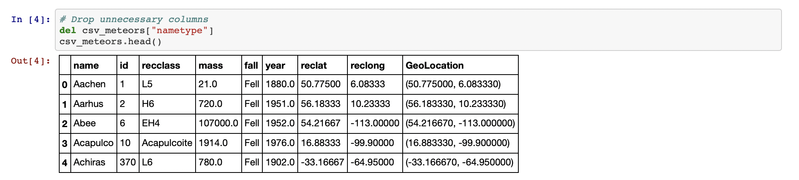
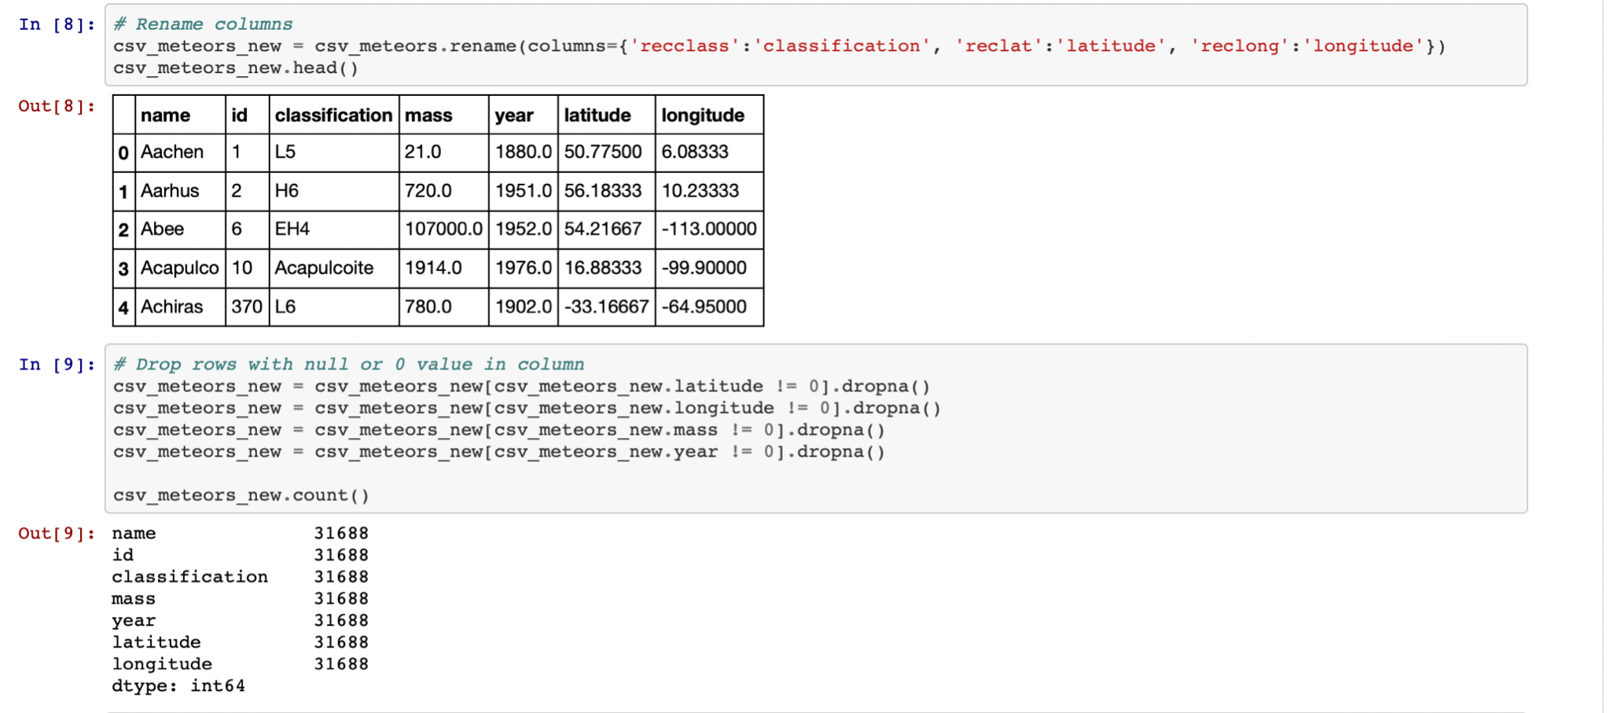
Data Cleanup
Jupyter Notebook was used to perform the following:
Delete all rows with blank cells and zero values
Rename Columns
Drop NA value cells
Delete rows with meteor mass less than 10000
Converted csv to json file

Slide 5
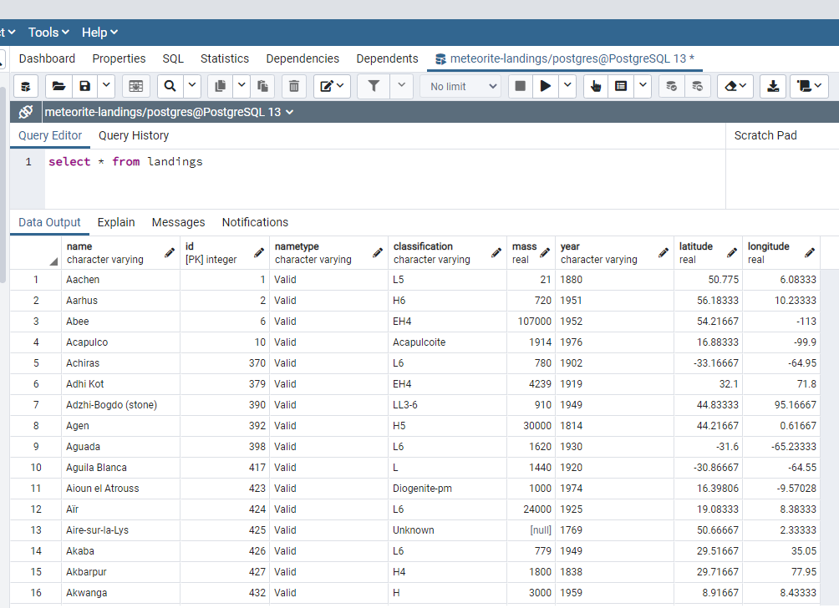
Database: PostgreSQL
Created table in Postgres
Uploaded dataset (csv) to Postgres, only keeping relevant columns
Notes:
We then created a table in Postgres -> we then uploaded our cleaned csv file to postgres in order to generate a clean datatable

Slide 6
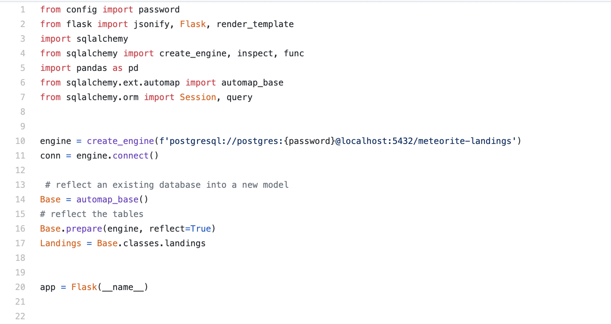
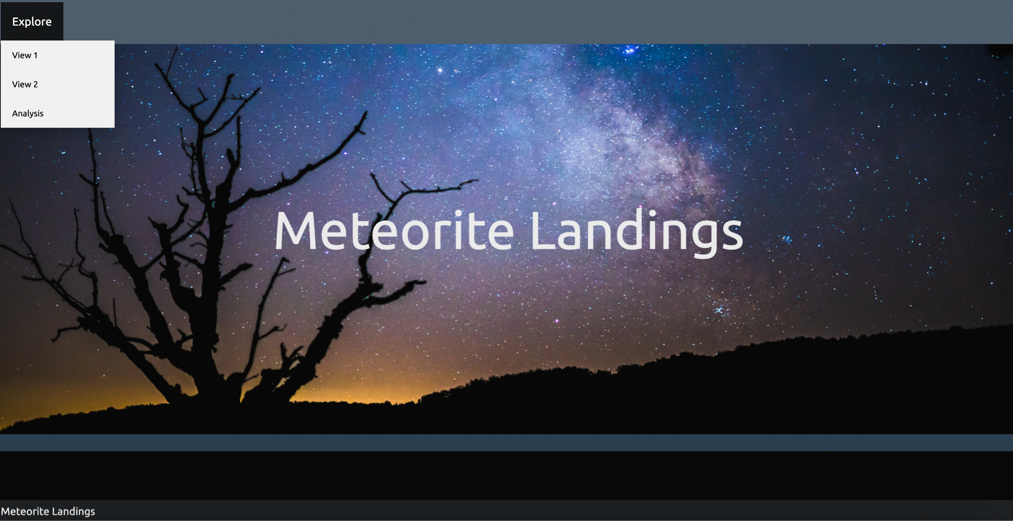
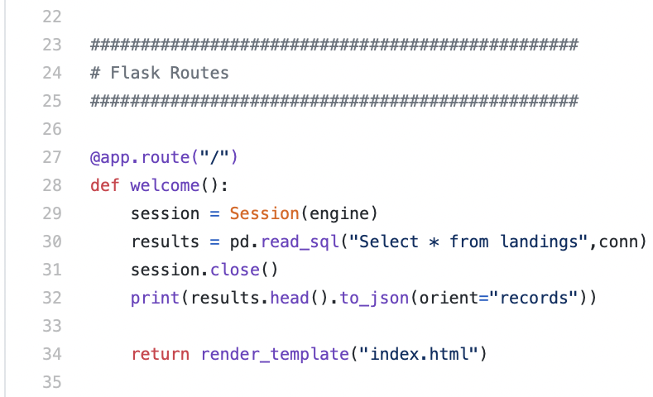
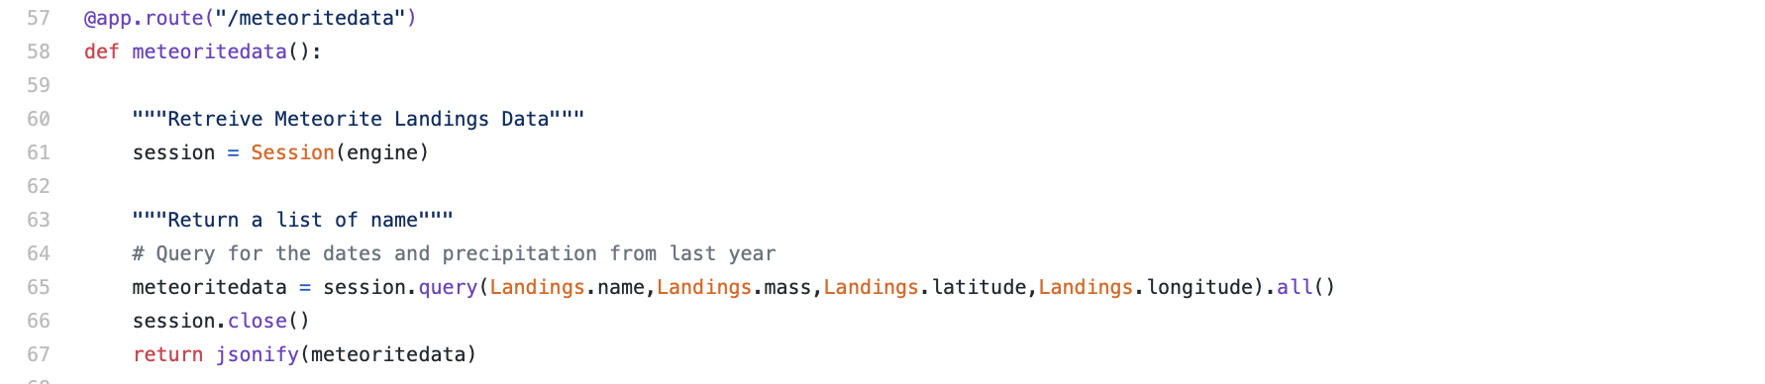
Flask - API
1
Created connection to Postgres
2
Create main route & utilize render
template
3
Create additional routes
Notes:
In our app.py file we created a connection to postgres using Flask.
Then we created a main route and utilize the render template to produce the index.html page.
We created additional routes to assign URLs in our app to function easily.
We created total of 7 different routes, an also utilized the “render templates”
We originally planned to use a dropdown menu on dashboard to display our map. However we had limitations using the routes to map our data due to time and data constraints.

Slide 7
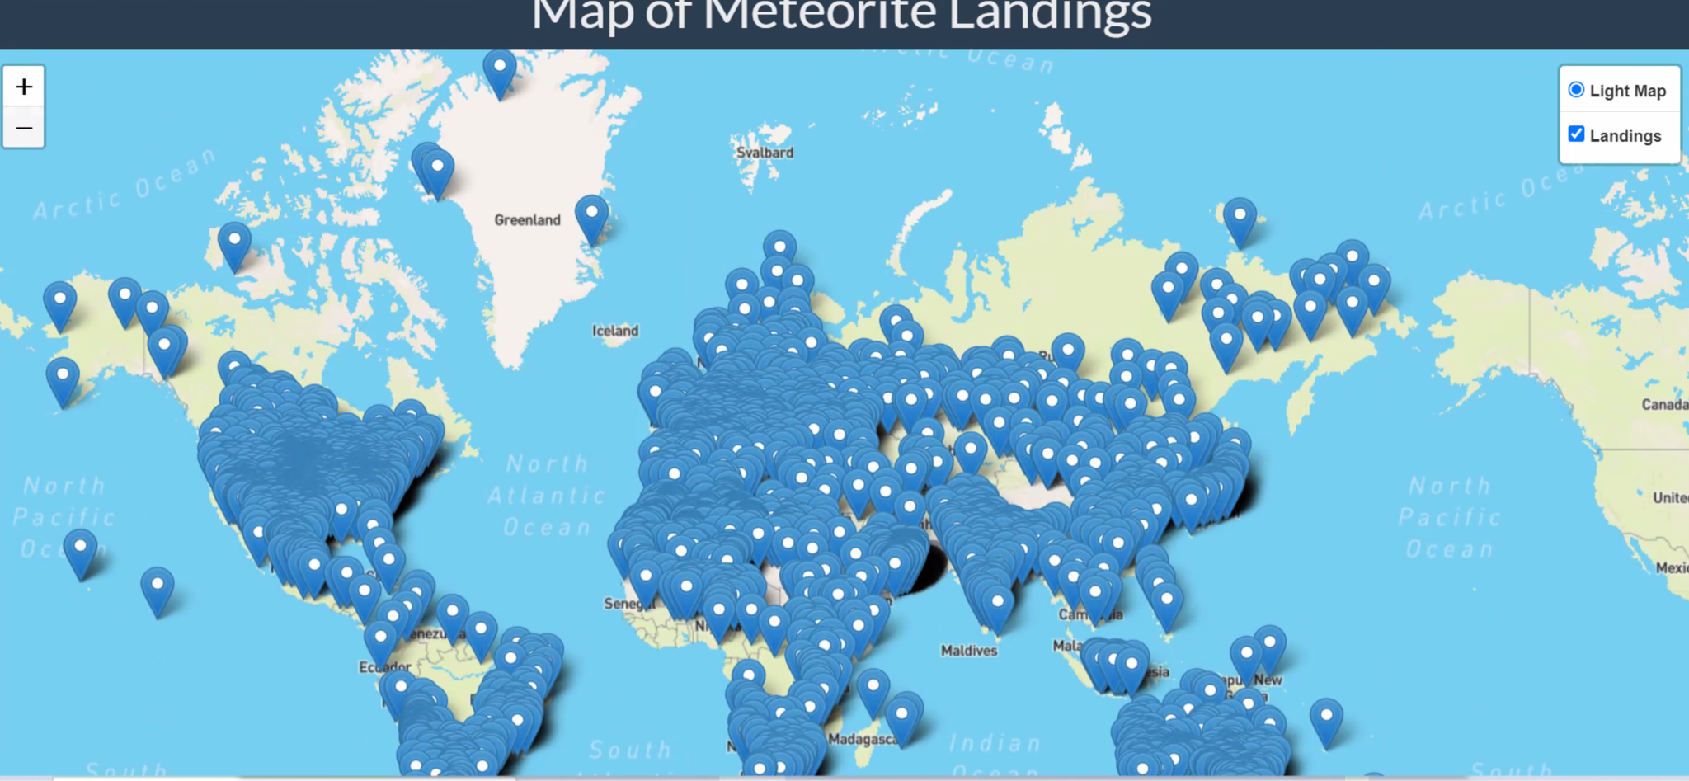
Mapping the Data: - View with 10,000+ data points
Notes:
limitation: We did not use our data using app.py file. We used the csv to map the data.

Slide 8
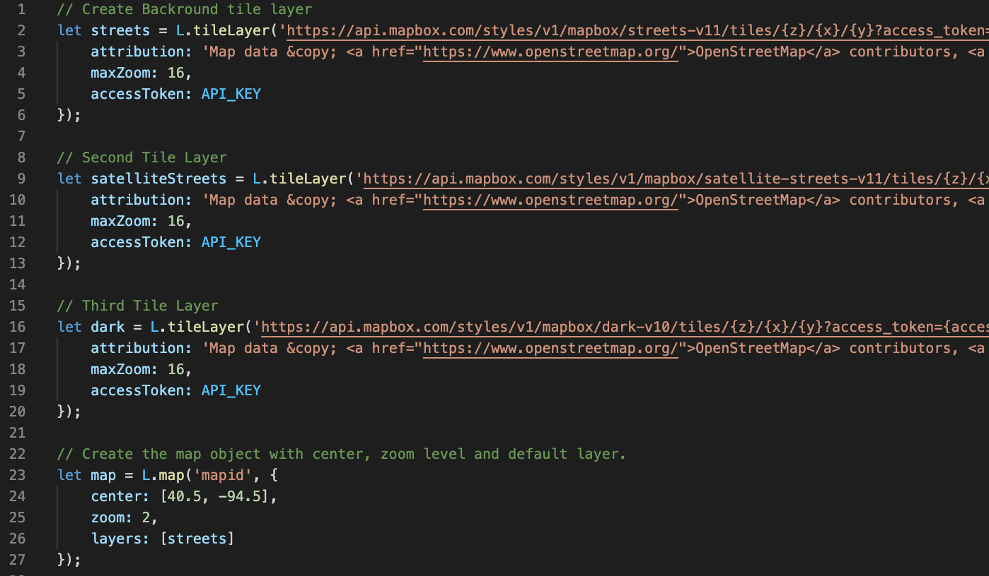
Mapping the Data: GeoJson Dataset
Data was mapped using GeoJson file and Leaflet
3 Different tile layers were used
Notes:
We also used a GeoJson version of our data set to map our data through Leaflet
We created 3 tile layers, and mapped markers of the 120 largest meteorite landings to observe their geolocations on our map, and marker colors were assigned based on classification
an if then statement was used to assign marker color, we only displayed data for the top 3 classifications. (L6, H5, Iron(IVB))
Now I will pass it off to Jess to talk about Visualization.

Slide 9
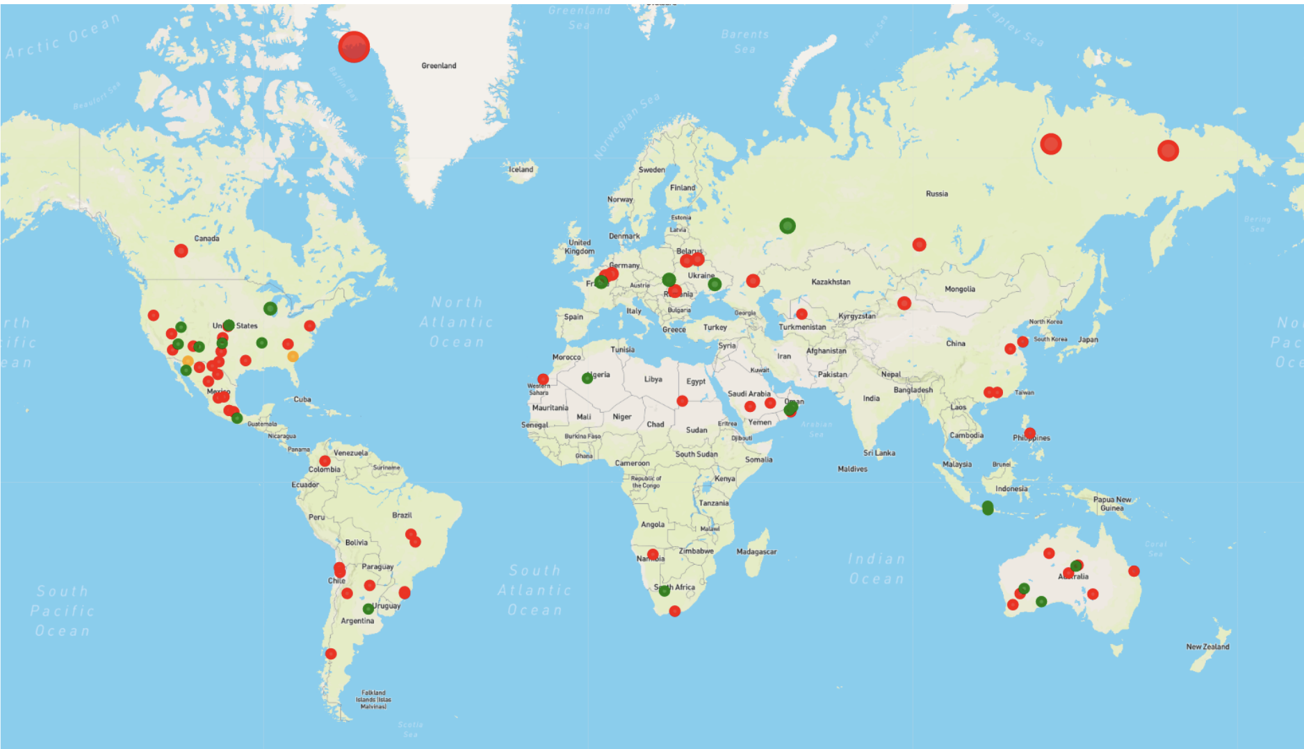
Mapping the Data: Street View Map
Notes:
This is a screenshot of the Street view tile-layer showing a total of 120 meteorite landings - each color represents the one of the 3 main classes

Slide 10
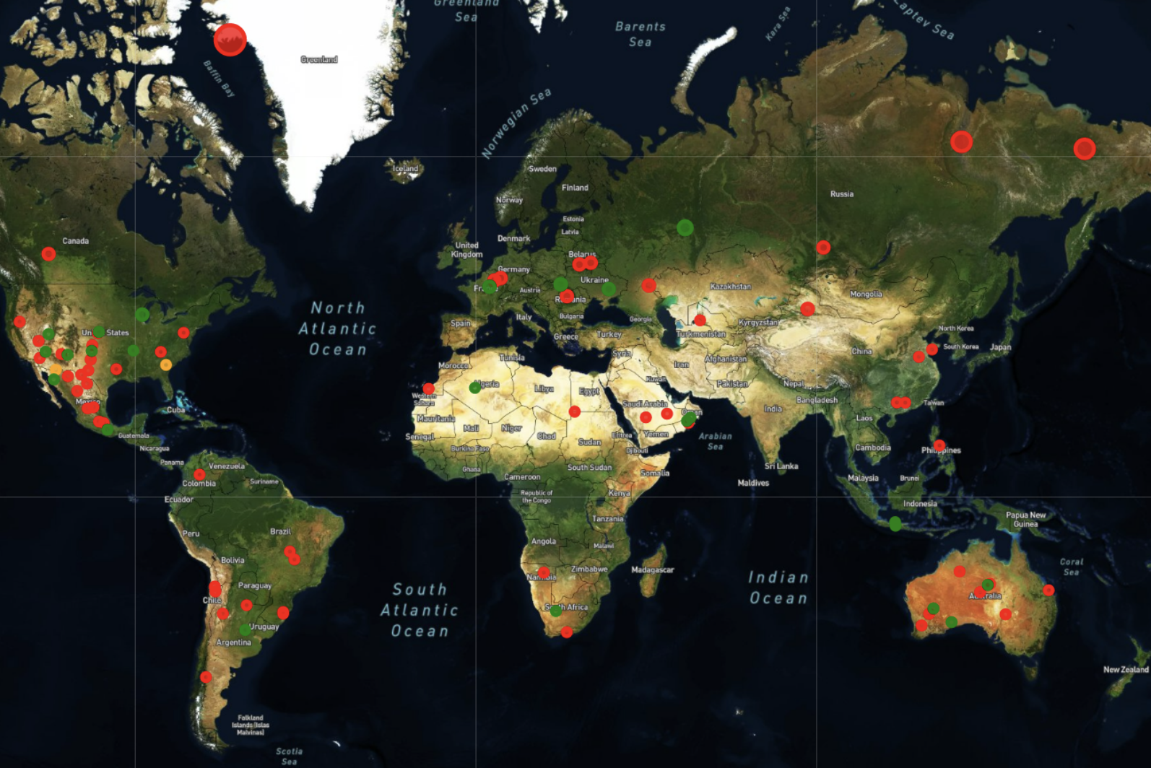
Mapping the Data: Satellite View Map
Notes:
This is a screenshot of the Satellite view tile-layer showing a total of 120 meteorite landings

Slide 11
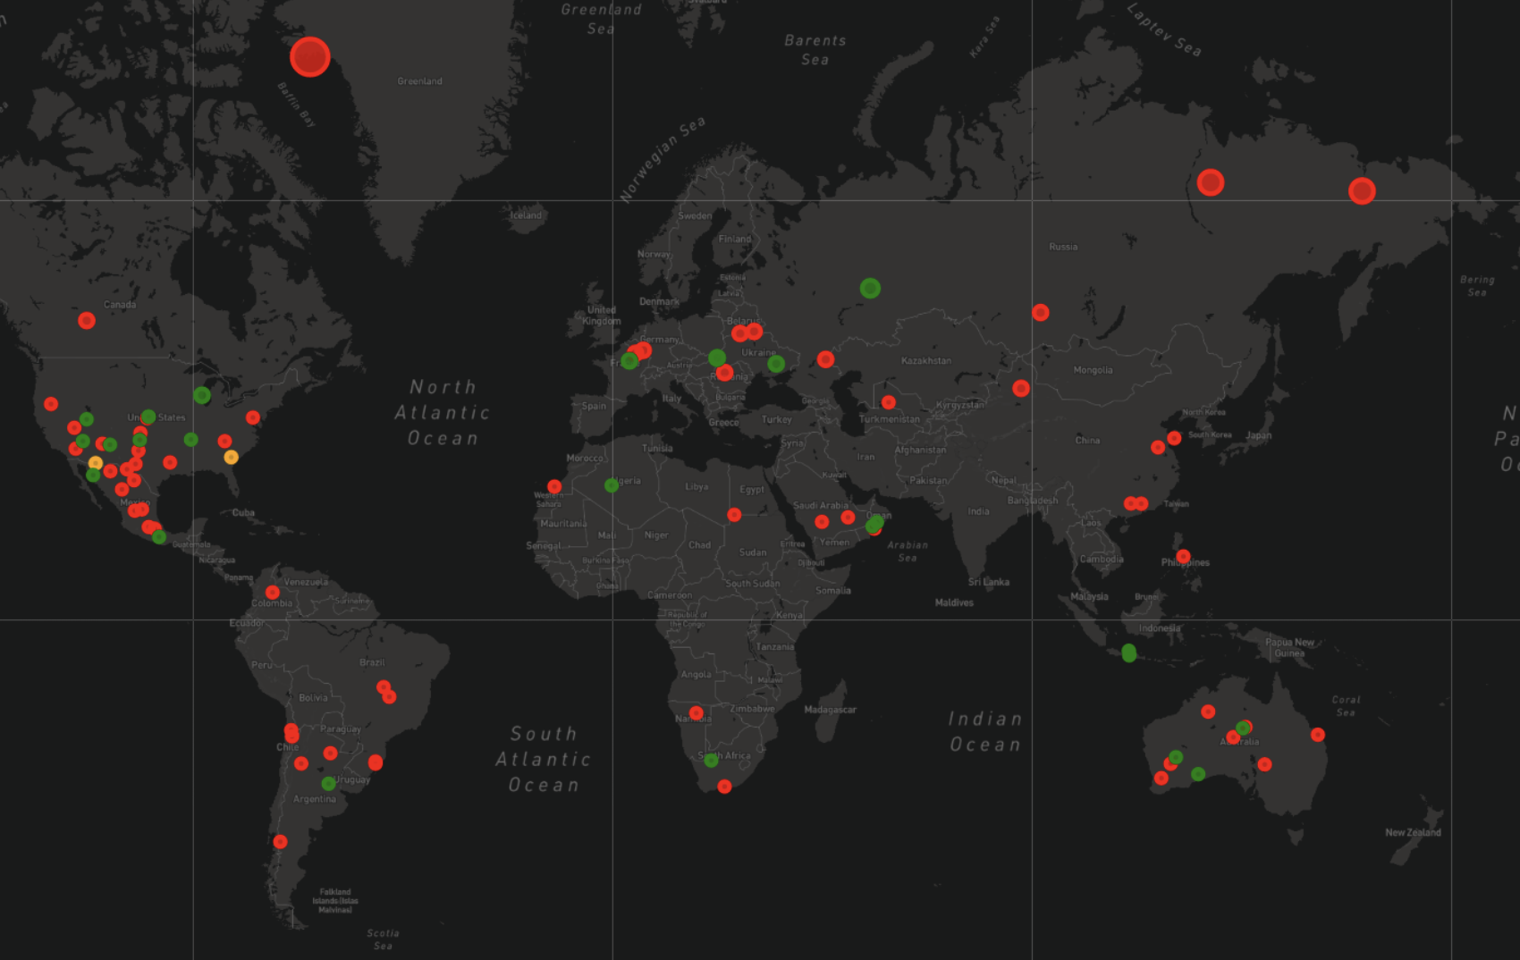
Mapping the Data: Dark View Map
Notes:
This is a screenshot of the Dark view tile-layer showing a total of 120 meteorite landings

Slide 12
Limitations
Dispersion of meteorite landings over Earth surface:
Limitations:
Original dataset too large
Difficult data structure in dataset
Too many classification groups and sub-groups (over 600 specific types)
Notes:
Original dataset was enormous with over 45,000 entries
Data structure was difficult to ???
Too many sub-classifications (over 600 specific types)

